Slide 1


Slide 2


Market Idea
Consider, we have a client who wants to increase their sales and target its customers with promotional offers. We would provide them with twitter analytics to find 10 most influential people within a range that can influence the target customers.

Slide 3








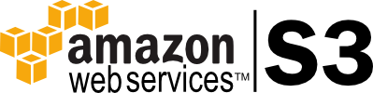
Tools Used

Slide 4

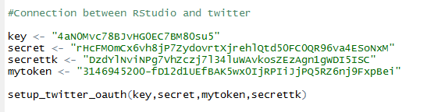

Data Extraction and Visualization

Slide 5

Data Extraction and Visualization

Slide 6

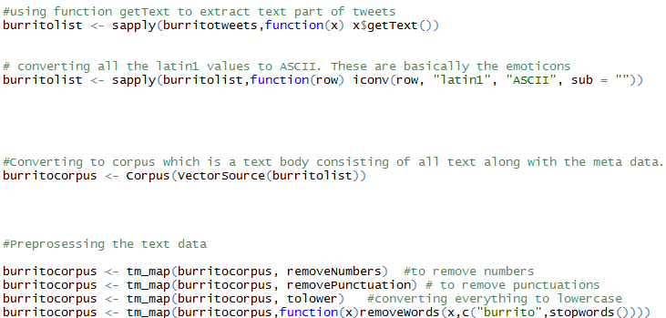
Data Extraction and Visualization
Pre-processing

Slide 7
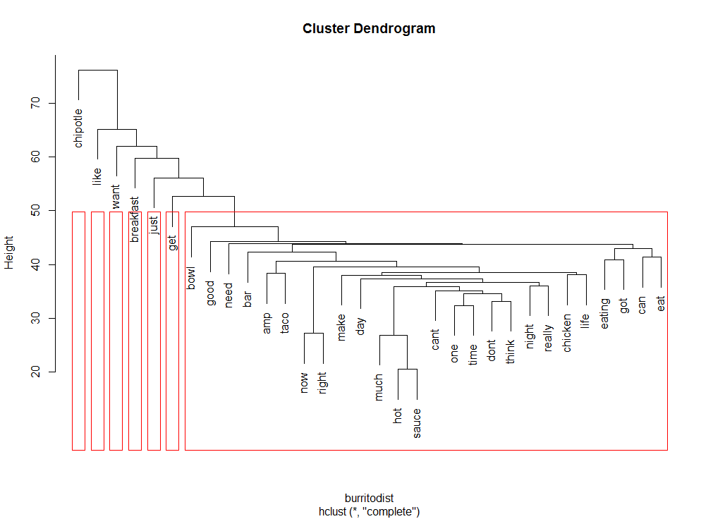
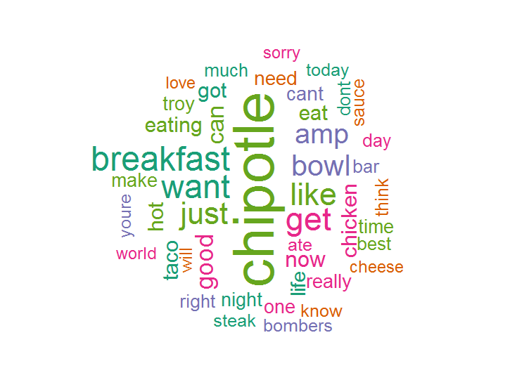
Visualizations
Cluster Dendogram

Slide 8

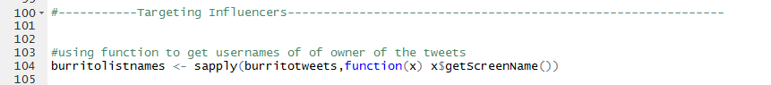
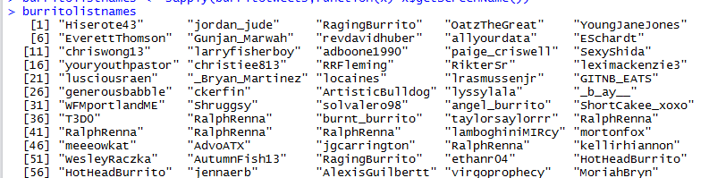
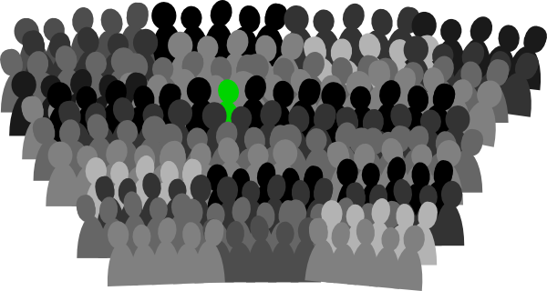
Influential Users

Slide 9
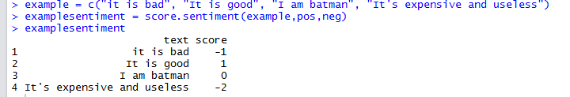
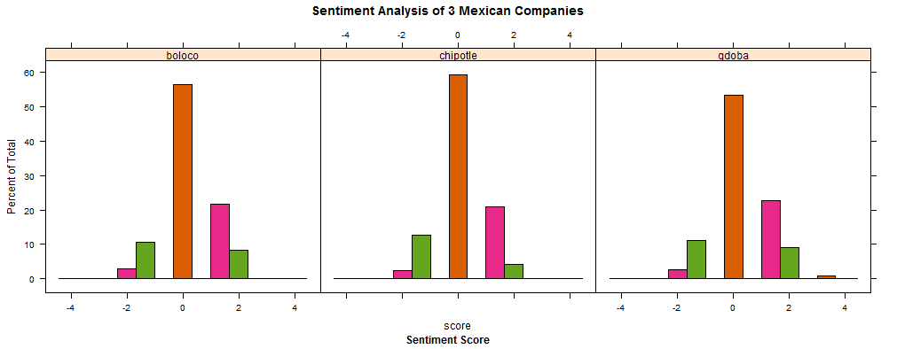
Sentimental Analysis

Slide 10

Machine Learning
Experimenting Twitter based Sentimental Analysis
A lexicon based approach has high precision but low coverage
A data-driven machine learning approach
Learns from a corpus of annotated tweets

Slide 11
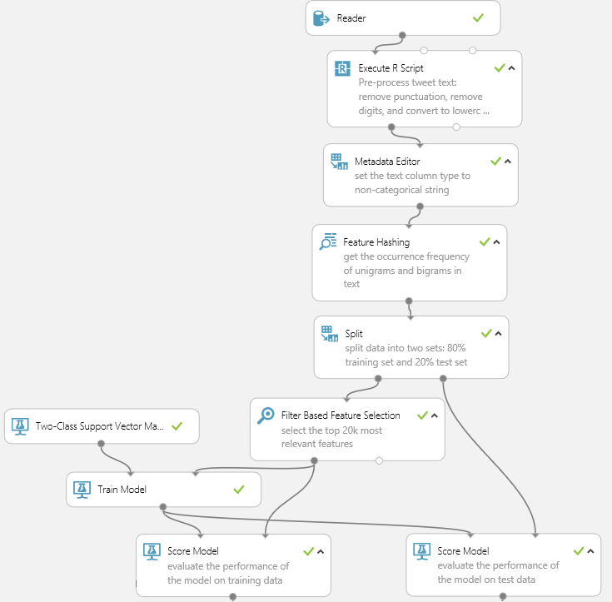
Machine Learning Steps
Step 1: Collect data
Step 2: Preprocessing text data in R
Step 3: Feature hashing and Filtered based feature selection
Step 4: Split the data into train and test
Step 5: Train model for prediction
Step 6: Evaluate model performance

Slide 12
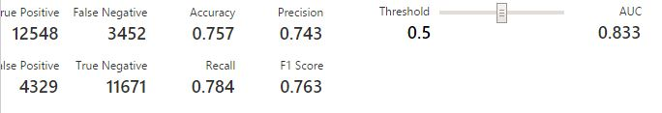
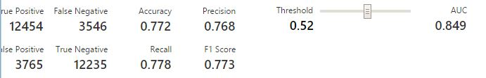
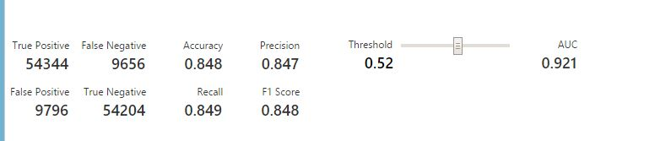
Validation Score
Support Vector Machine
Boosting Decision Tree
Logistic Regression

Slide 13
Top Influential People

Slide 14
Followers vs Status Count

Slide 15


vs

Slide 16
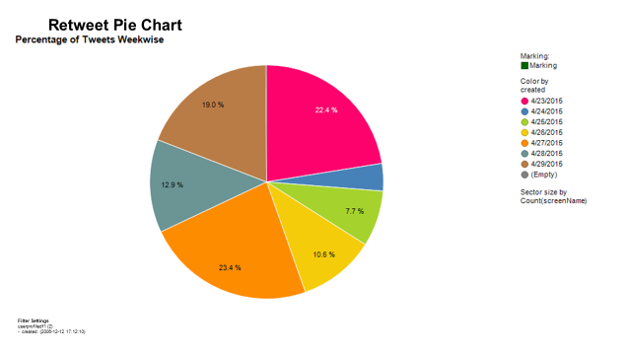
Retweet Analysis

Slide 17
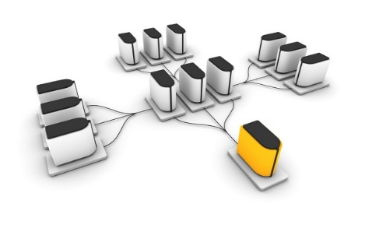


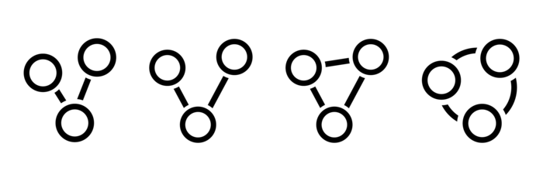


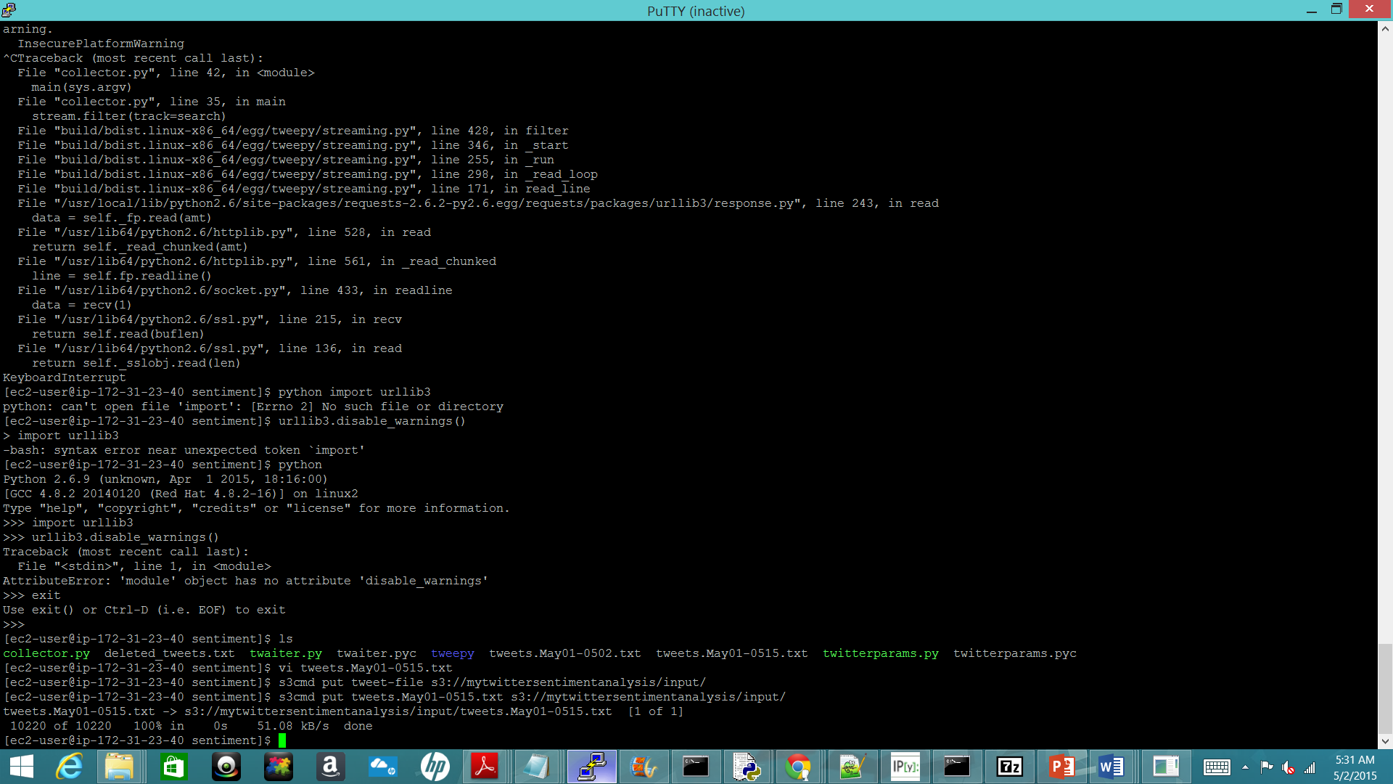


Implementation Using
Amazon EMR Clusters
Mapper in Python
Amazon Cloud Formation Stack
Master
Slave
Reduce
Output

Slide 18
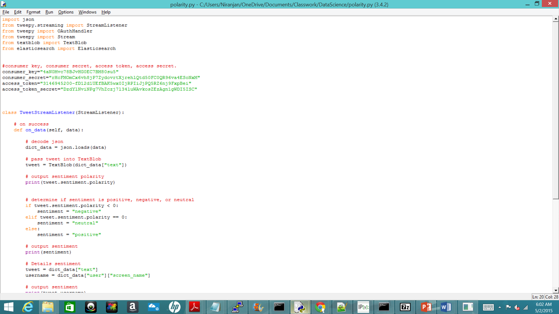
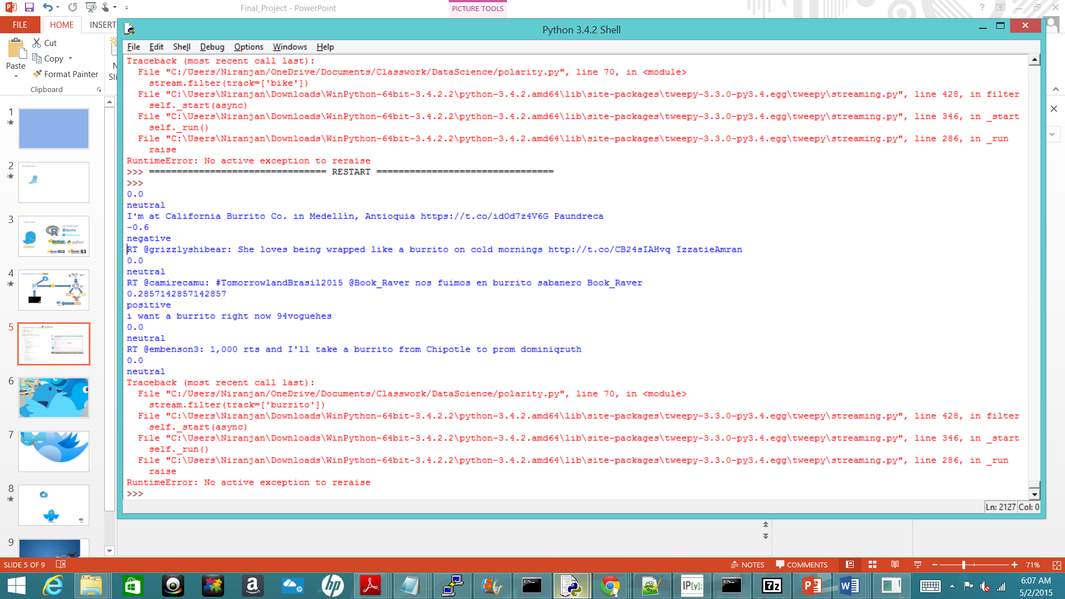
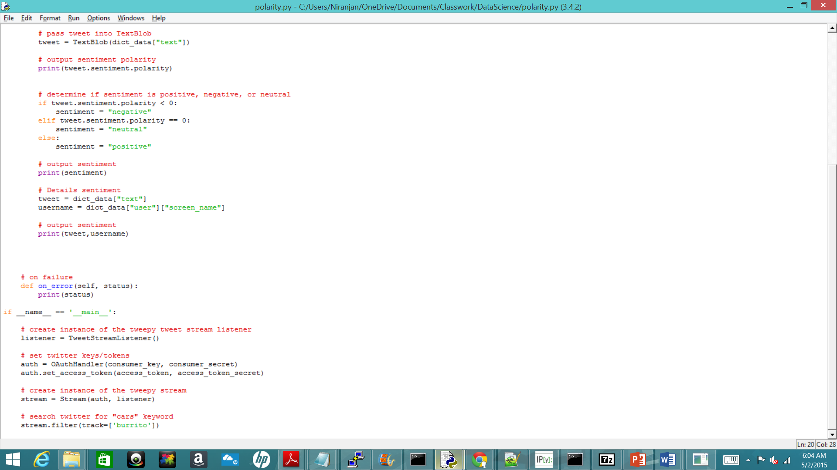
Implementation Using
OUTPUT:

Slide 19
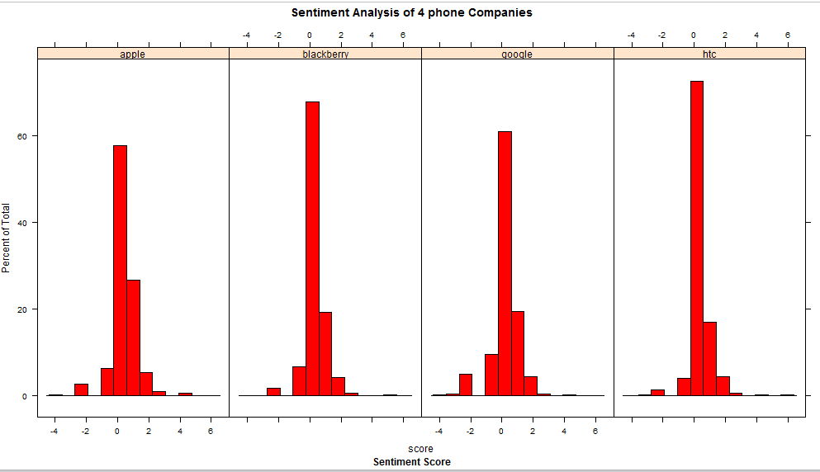
Power of Sentiments

Slide 20
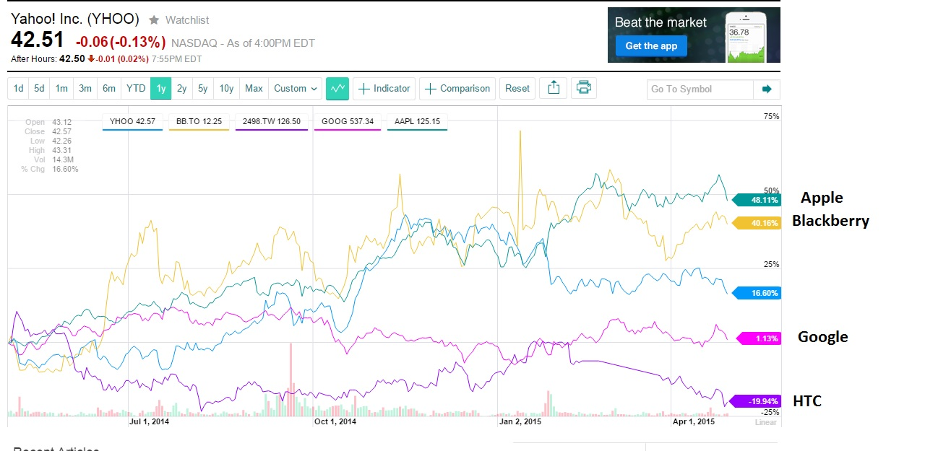
Power of Sentiments

Slide 21

#ThankYou

